Slide 1
Meeting the Needs of TAG and Accelerated Students
(Secondary)
Agenda:
Introductions
Data and programs
Possible options for your school
1
Notes:
1

Slide 2
Conifer High School Mission
Always striving to be a caring learning community, focusing on an innovative, challenging curriculum and preparing all our students emotionally, intellectually, and physically for success today and tomorrow.
Challenges
Demographic Data
1000 students (Suburban/Rural)
92% White
15% Free and Reduced
19% TAG
88% Graduation Rate
TAG graduation rate 80%
Zero honors classes
7 AP courses (206 students taking 338 tests: 1.19 per senior)
40-45 of the top students in the 8th grade open enrolled at the IB school 33 miles away.

Slide 3
AP Potential to Predict “Grade 13” Success

Slide 4
Creating Intentional Pathways for TAG and Accelerated Students https://drive.google.com/open?id=0B9imbUva9m3mMTB0MXVCU3dYOHM

Slide 5
5 Year Data Trend
https://drive.google.com/open?id=0B9imbUva9m3mSjhUcENGVG9NNWs

Slide 6
Conifer High School Mission
Always striving to be a caring learning community, focusing on an innovative, challenging curriculum and preparing all our students emotionally, intellectually, and physically for success today and tomorrow.
Outcomes
Demographic Data
Honors classes in English, science, math 9th-10th. TAG plans and PSAT (AP Potential) review for AP. Social studies honors pathway became AP.
17 AP courses plus 11 “Grade 13” courses (386 students taking 750 AP tests: 3.47 tests per senior)
4 of the top students in the 8th grade enrolled in private schools.
800 students (Suburban/Rural)
92% White
15% Free and Reduced
19% TAG
94 % Graduation Rate
TAG graduation rate 98%

Slide 7
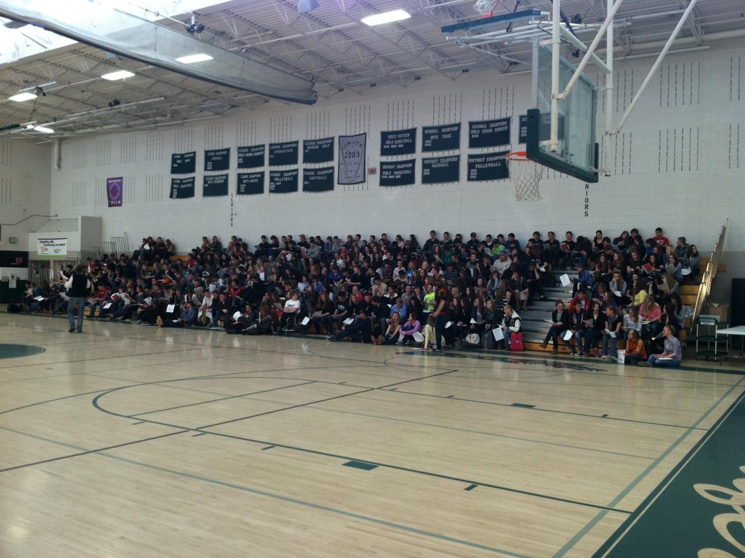
Grade 13 Assembly

